Slide 1
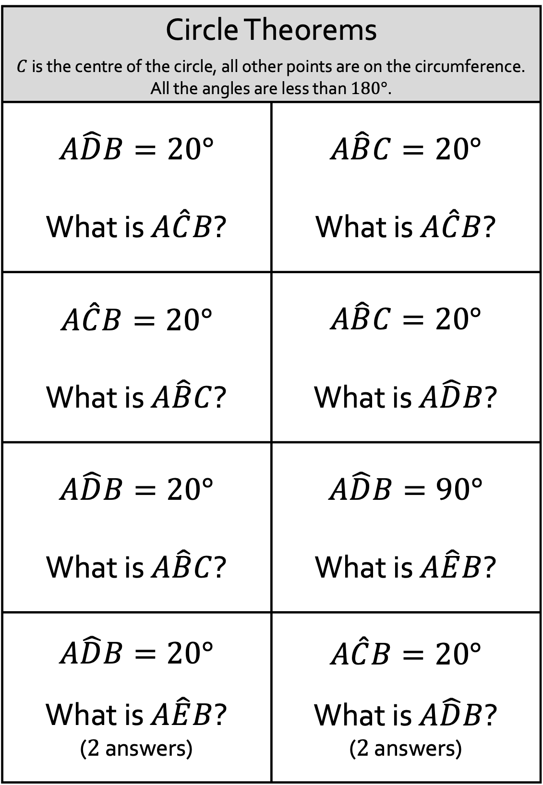
Circle Theorems
$C$ is the centre of the circle, all other points are on the circumference. All the angles are less than $180°$.
$$A\hat{D}B=20°$$ What is $A\hat{C}B$? | $$A\hat{B}C=20°$$ What is $A\hat{C}B$?
$$A\hat{C}B=20°$$ What is $A\hat{B}C$? | $$A\hat{B}C=20°$$ What is $A\hat{D}B$?
$$A\hat{D}B=20°$$ What is $A\hat{B}C$? | $$A\hat{D}B=90°$$ What is $A\hat{E}B$?
$$A\hat{D}B=20°$$ What is $A\hat{E}B$? ($2$ answers) | $$A\hat{C}B=20°$$ What is $A\hat{D}B$? ($2$ answers)

Slide 2
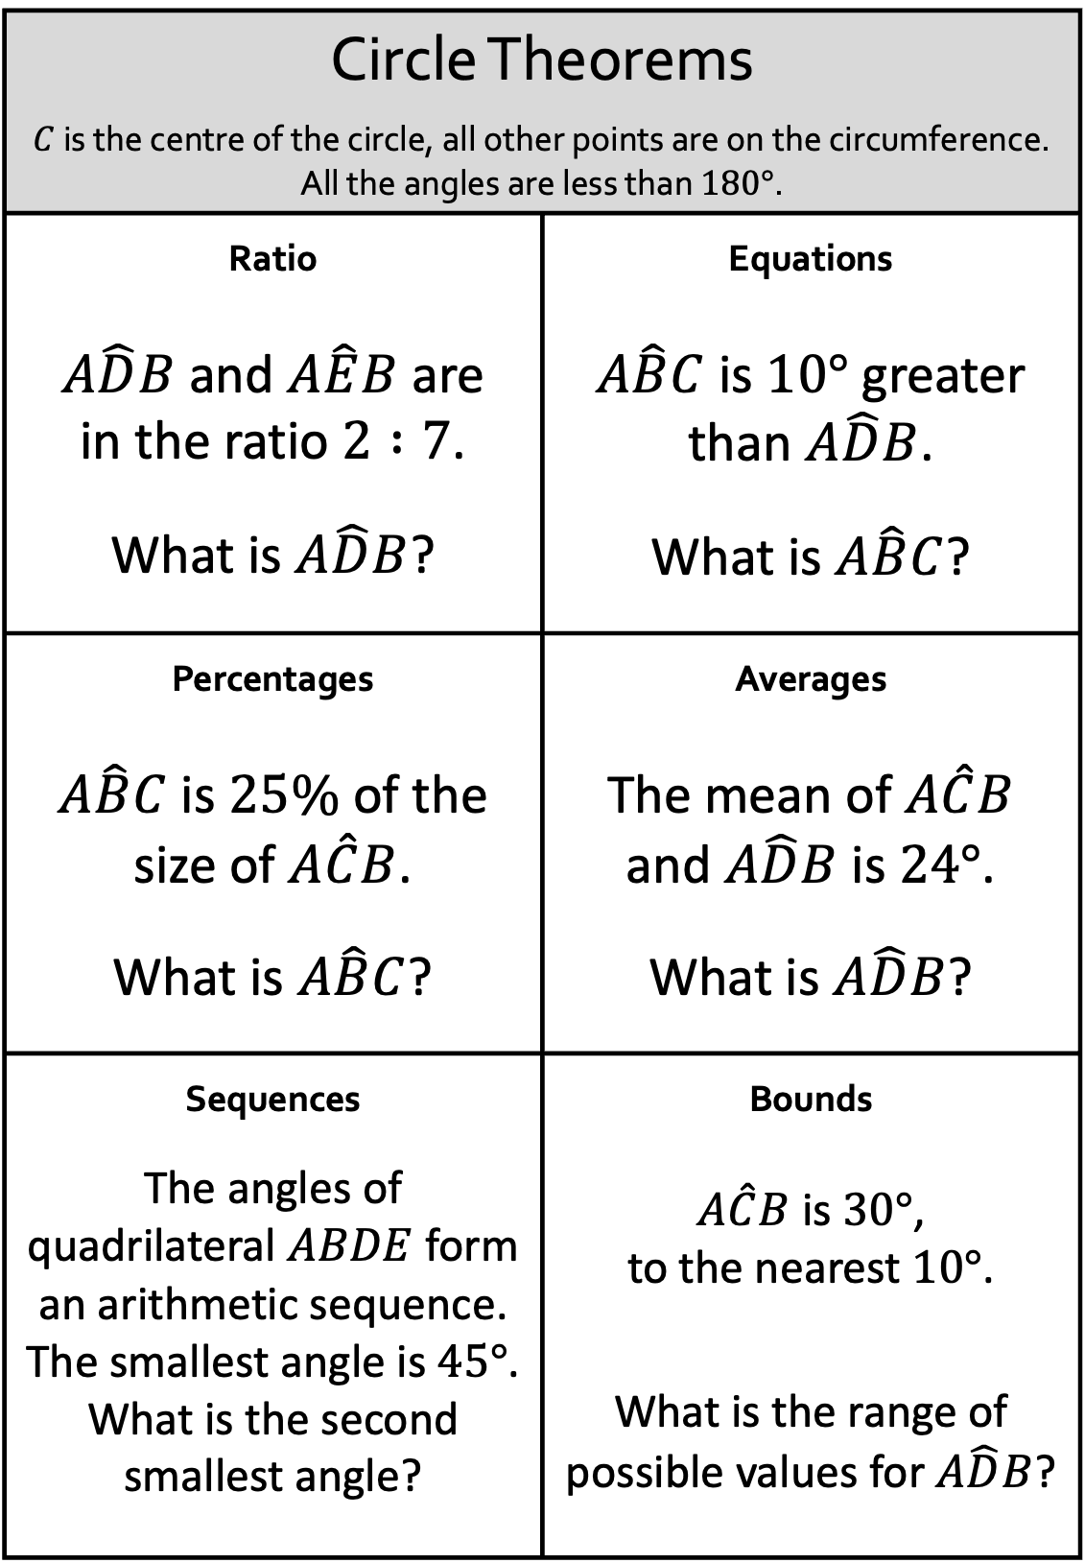
Circle Theorems
$C$ is the centre of the circle, all other points are on the circumference. All the angles are less than $180°$.
Ratio $A\hat{D}B$ and $A\hat{E}B$ are in the ratio $2 :7$. What is $A\hat{D}B$? | Equations $A\hat{B}C$ is $10°$ greater than $A\hat{D}B$. What is $A\hat{B}C$?
Percentages $A\hat{B}C$ is $25\%$ of the size of $A\hat{C}B$. What is $A\hat{B}C$? | Averages The mean of $A\hat{C}B$ and $A\hat{D}B$ is $24°$. What is $A\hat{D}B$?
Sequences The angles of quadrilateral $ABDE$ form an arithmetic sequence. The smallest angle is $45°$. What is the second smallest angle? | Bounds $A\hat{C}B$ is $30°$, to the nearest $10°$. What is the range of possible values for $A\hat{D}B$?

Slide 3
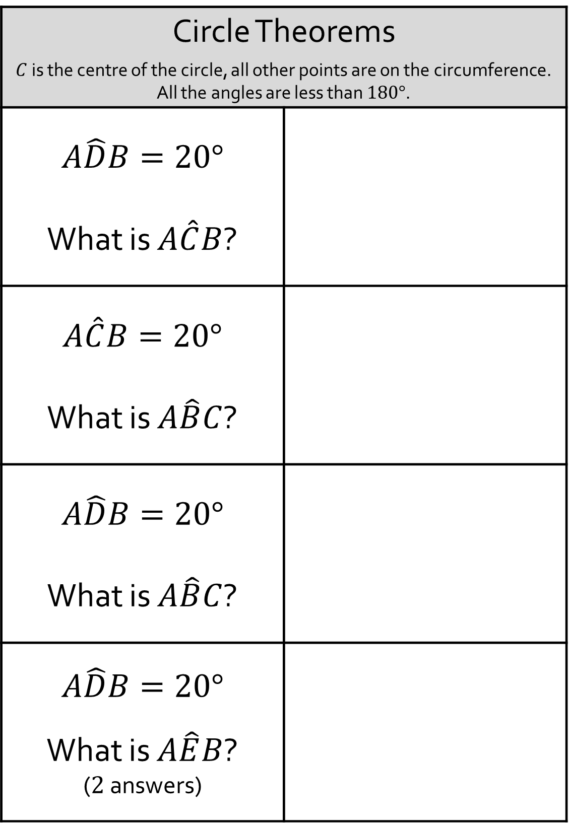
Circle Theorems
$C$ is the centre of the circle, all other points are on the circumference. All the angles are less than $180°$.
$$A\hat{D}B=20°$$ What is $A\hat{C}B$?
$$A\hat{C}B=20°$$ What is $A\hat{B}C$?
$$A\hat{D}B=20°$$ What is $A\hat{B}C$?
$$A\hat{D}B=20°$$ What is $A\hat{E}B$? ($2$ answers)

Slide 4

Circle Theorems
$C$ is the centre of the circle, all other points are on the circumference. All the angles are less than $180°$.
$$A\hat{B}C=20°$$ What is $A\hat{C}B$?
$$A\hat{B}C=20°$$ What is $A\hat{D}B$?
$$A\hat{D}B=90°$$ What is $A\hat{E}B$?
$$A\hat{C}B=20°$$ What is $A\hat{D}B$? ($2$ answers)

Slide 5
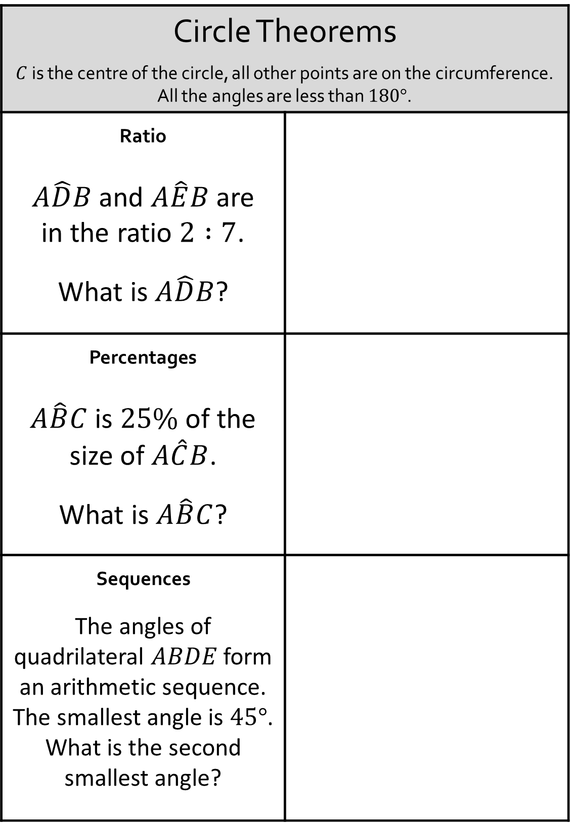
Circle Theorems
$C$ is the centre of the circle, all other points are on the circumference. All the angles are less than $180°$.
Ratio $A\hat{D}B$ and $A\hat{E}B$ are in the ratio $2 :7$. What is $A\hat{D}B$?
Percentages $A\hat{B}C$ is $25\%$ of the size of $A\hat{C}B$. What is $A\hat{B}C$?
Sequences The angles of quadrilateral $ABDE$ form an arithmetic sequence. The smallest angle is $45°$. What is the second smallest angle?

Slide 6
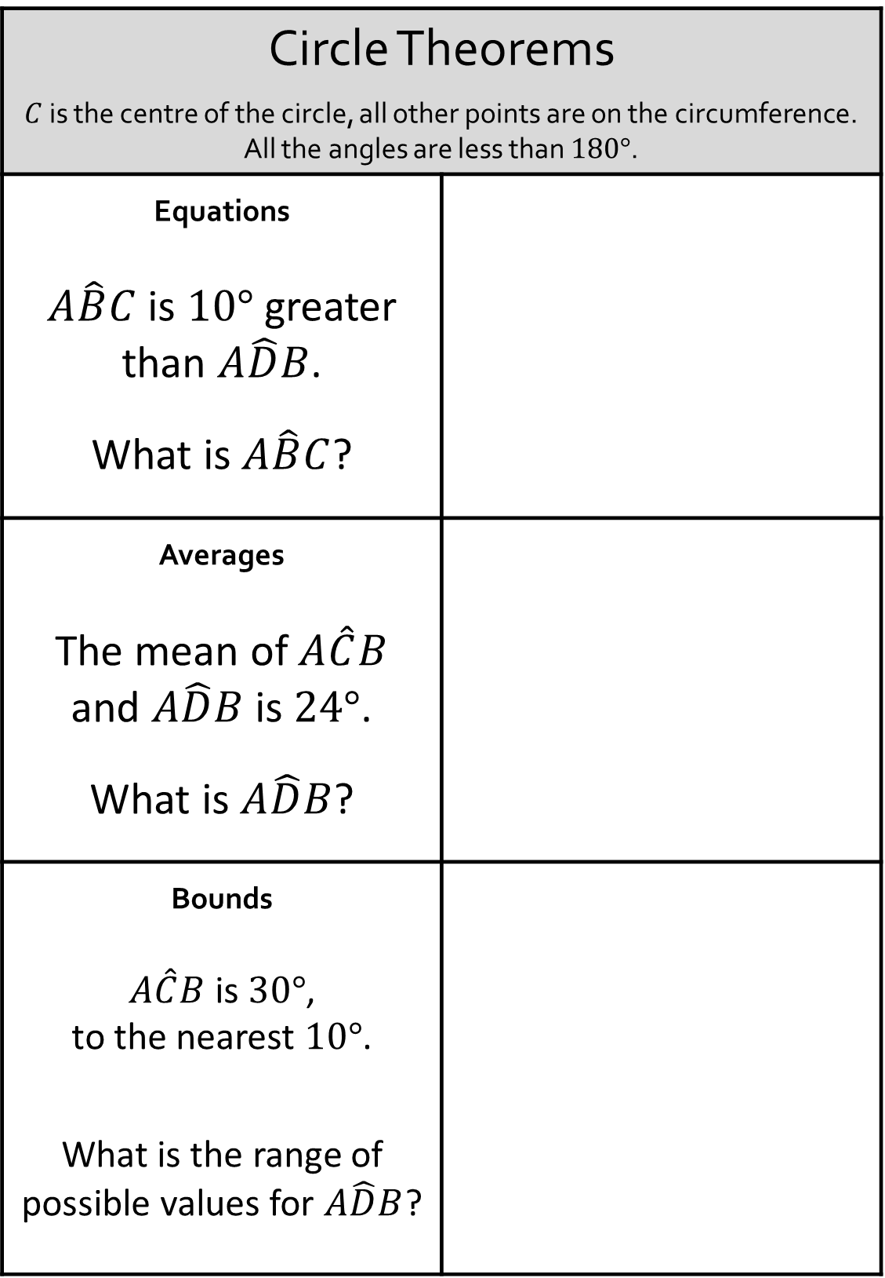
Circle Theorems
$C$ is the centre of the circle, all other points are on the circumference. All the angles are less than $180°$.
Equations $A\hat{B}C$ is $10°$ greater than $A\hat{D}B$. What is $A\hat{B}C$?
Averages The mean of $A\hat{C}B$ and $A\hat{D}B$ is $24°$. What is $A\hat{D}B$?
Bounds $A\hat{C}B$ is $30°$, to the nearest $10°$. What is the range of possible values for $A\hat{D}B$?

Slide 7
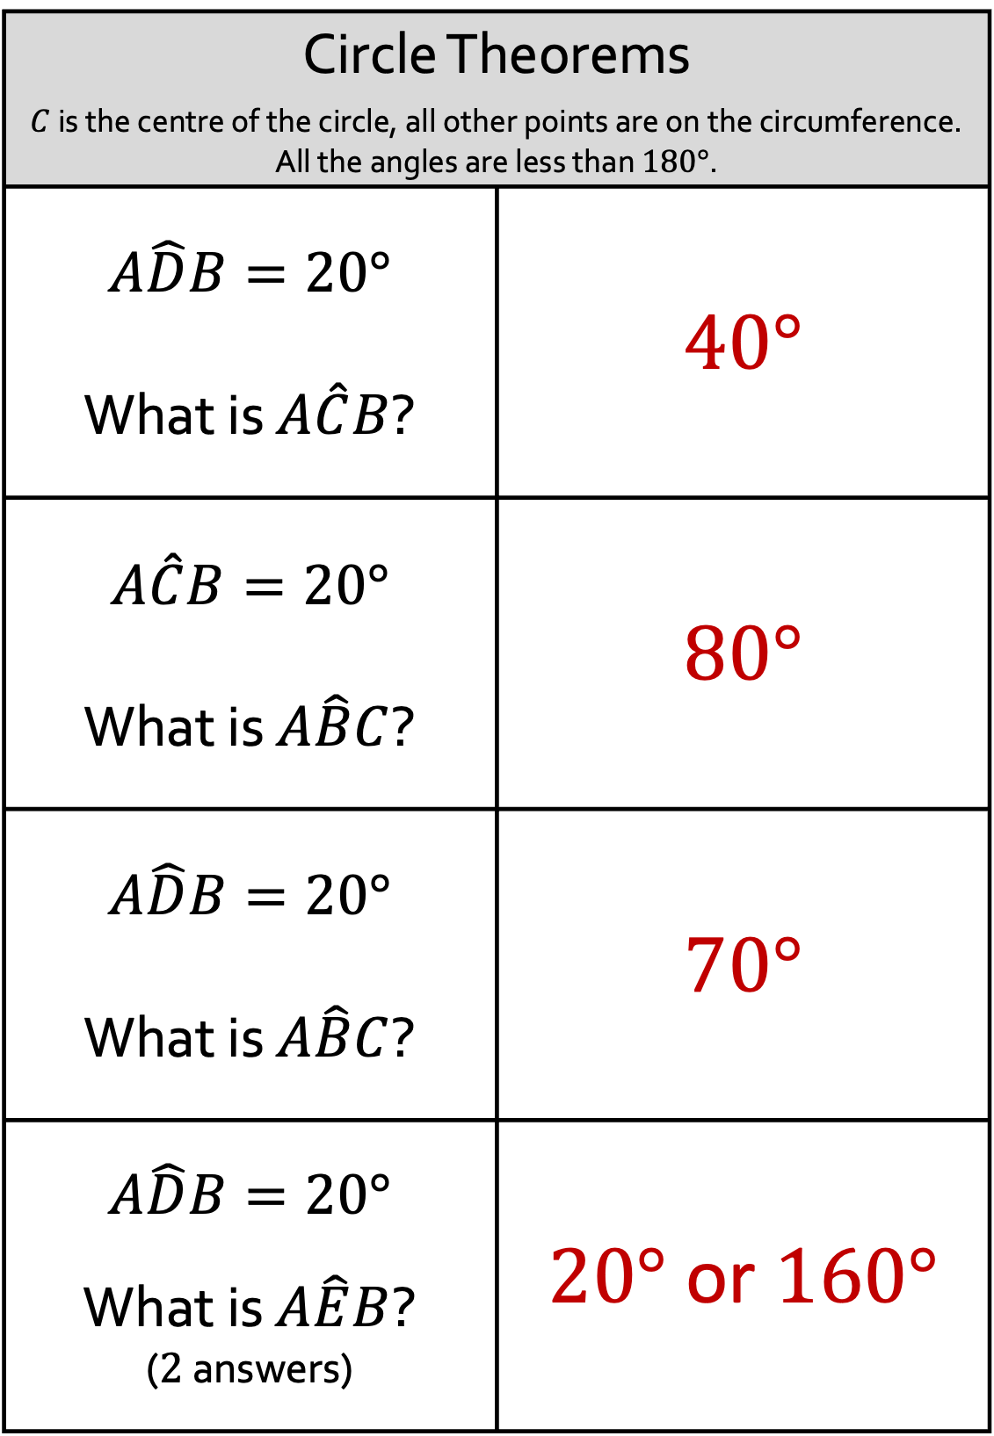
Circle Theorems
$C$ is the centre of the circle, all other points are on the circumference. All the angles are less than $180°$.
$$A\hat{D}B=20°$$ What is $A\hat{C}B$? | $40°$
$$A\hat{C}B=20°$$ What is $A\hat{B}C$? | $80°$
$$A\hat{D}B=20°$$ What is $A\hat{B}C$? | $70°$
$$A\hat{D}B=20°$$ What is $A\hat{E}B$? ($2$ answers) | $20°$ or $160°$

Slide 8
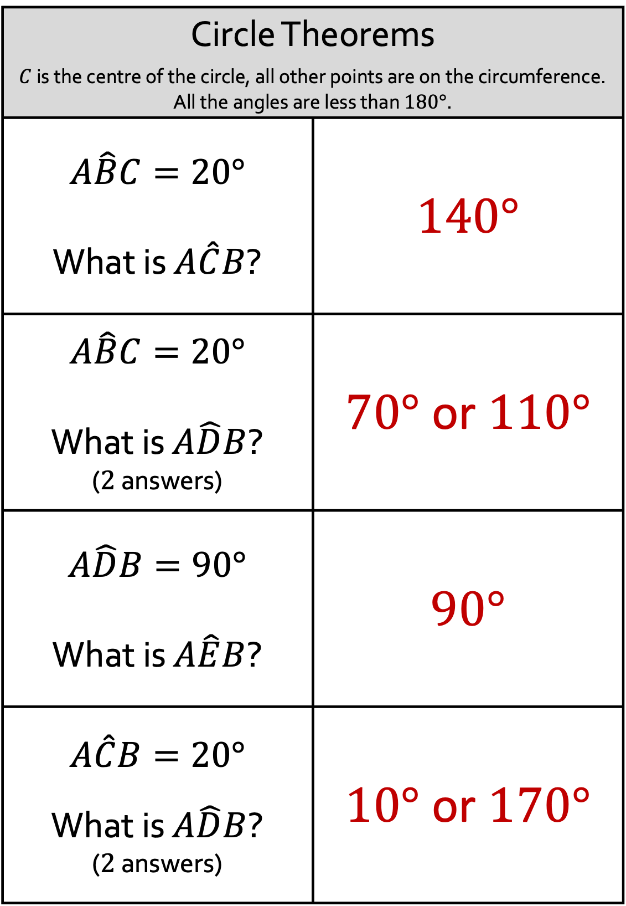
Circle Theorems
$C$ is the centre of the circle, all other points are on the circumference. All the angles are less than $180°$.
$$A\hat{B}C=20°$$ What is $A\hat{C}B$? | $140°$
$$A\hat{B}C=20°$$ What is $A\hat{D}B$? ($2$ answers) | $70°$ or $110°$
$$A\hat{D}B=90°$$ What is $A\hat{E}B$? | $90°$
$$A\hat{C}B=20°$$ What is $A\hat{D}B$? ($2$ answers) | $10°$ or $170°$

Slide 9
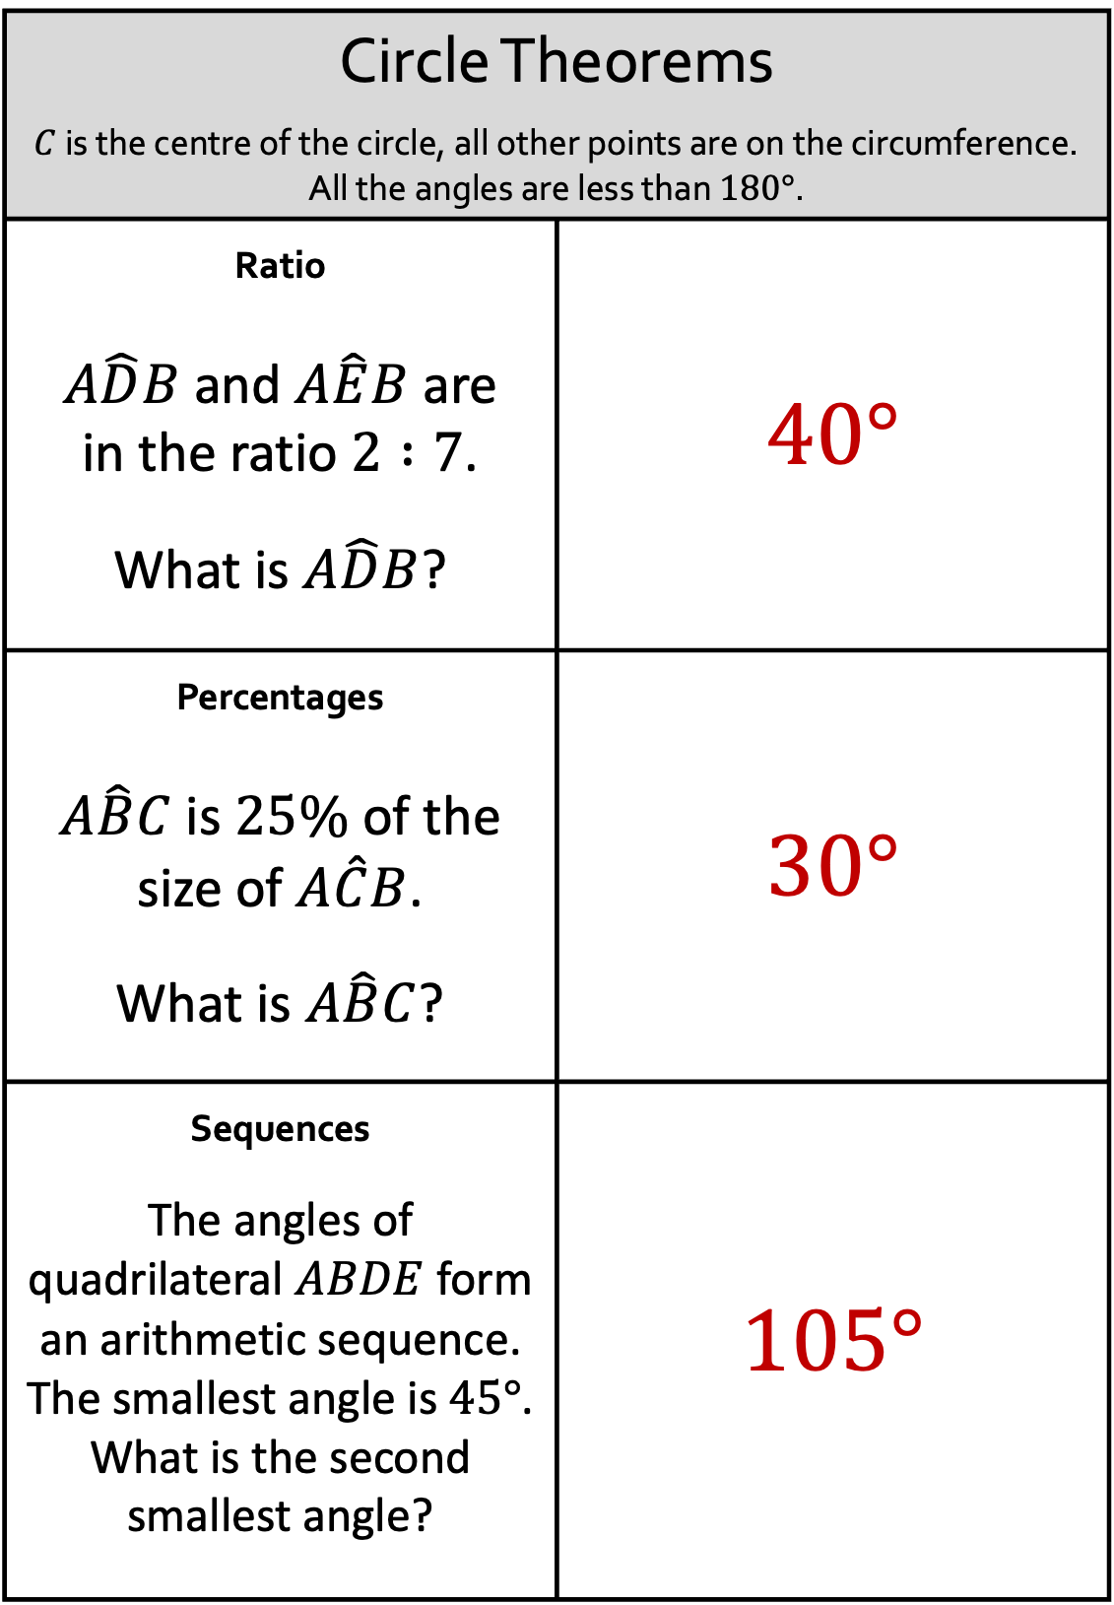
Circle Theorems
$C$ is the centre of the circle, all other points are on the circumference. All the angles are less than $180°$.
Ratio $A\hat{D}B$ and $A\hat{E}B$ are in the ratio $2 :7$. What is $A\hat{D}B$? | $40°$
Percentages $A\hat{B}C$ is $25\%$ of the size of $A\hat{C}B$. What is $A\hat{B}C$? | $30°$
Sequences The angles of quadrilateral $ABDE$ form an arithmetic sequence. The smallest angle is $45°$. What is the second smallest angle? | $105°$

Slide 10
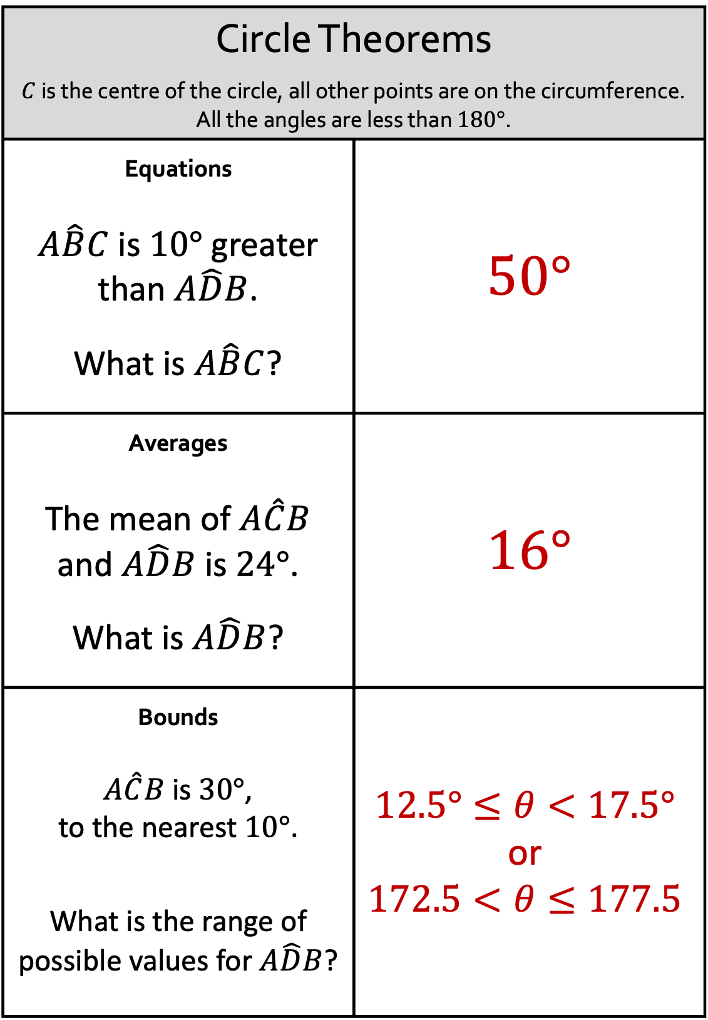
Circle Theorems
$C$ is the centre of the circle, all other points are on the circumference. All the angles are less than $180°$.
Equations $A\hat{B}C$ is $10°$ greater than $A\hat{D}B$. What is $A\hat{B}C$? | $50°$
Averages The mean of $A\hat{C}B$ and $A\hat{D}B$ is $24°$. What is $A\hat{D}B$? | $16°$
Bounds $A\hat{C}B$ is $30°$, to the nearest $10°$. What is the range of possible values for $A\hat{D}B$? | $$12.5°≤θ<17.5°$$ or $$172.5<θ≤177.5$$

